Slide 1
Choosing Distribution Parameters for faster
convergence of Routing Protocols in highly mobile environment
Shivam Choudhary
(sc3973)

Slide 2
Motivation
Devices are getting smaller
On Demand Routing requires sender to wait till ACK is received
Quantifying the bounds on message delivery

Slide 3
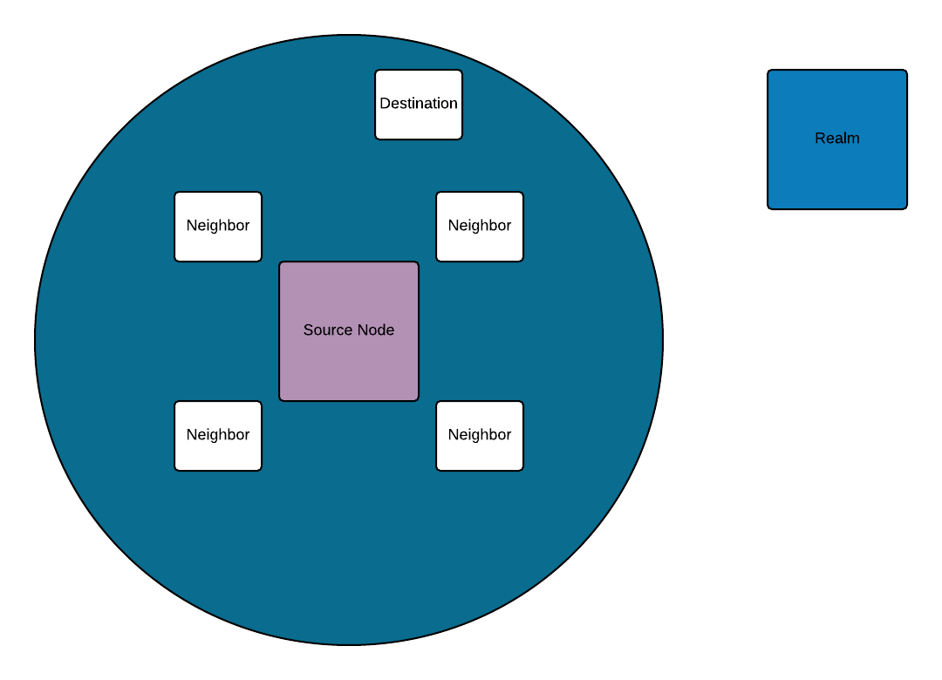
Model
Destination might/might not be in the range.
No Neighbor can be outside the Realm.
Range of each node is assumed to be constant.
Destination is assumed to be fixed
Nodes change position after each tick.

Slide 4
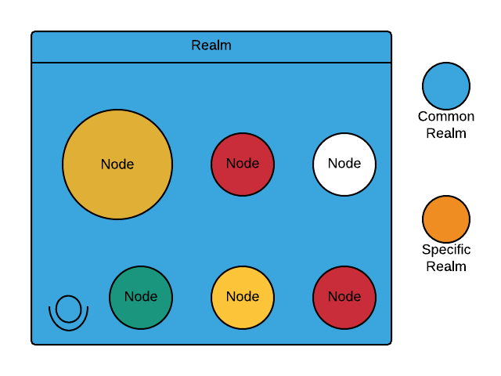
Realm Definition
Realm is the boundary in which the devices are present/can interact.
A device is defined to have two realms:-
Common and Specific.

Slide 5
Realm Boundary Condition
Common Realm:-
Bounded by the euclidean distance between destination and a node,hence for at-least one node the condition
should hold true,where R is the range of node.
Specific Realm:-
Specific realm is node dependent,defined consisting of a circle of radius R with center at node.

Slide 6
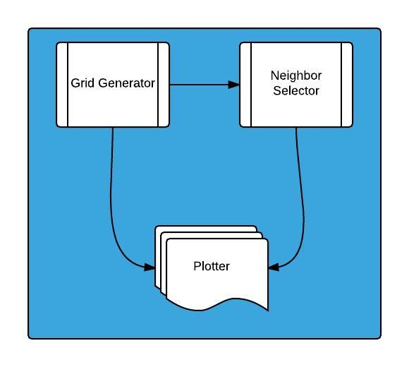
Architecture of Simulation
Grid Generator: Selects the realm and generates the boundary.
Neighbor Selector: Selects neighbor based on some distribution.
Plotter: User interface for plotting the graph.

Slide 7
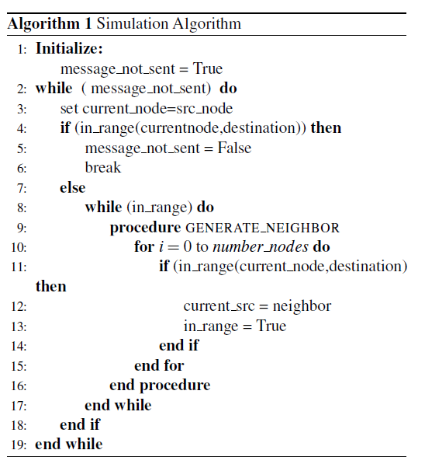
Algorithm for Simulation
Assumes Nodes are extremely mobile,changes position in every tick.
Hot Potato Routing: Node gets rid of packet as soon as it finds a neighbor in range
Stopping Condition: Algorithm converges when message is delivered to the end node.
Assumed that destination irrespective of number of hops would accept the data.

Slide 8
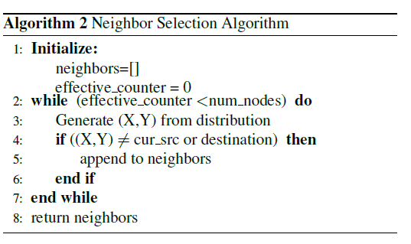
Neighbor Selection Algorithm
Called Recursively by simulation algorithm.
Returns nodes which are in specific realm of the current source node.
Selects nodes based on certain distribution

Slide 9
Running Simulations
Destination and Range dictates the selection of Common Realm.
For an experiment distribution for selecting the nodes is kept constant.
Range and Number of Nodes are varied.
Repeated for 3 different types of distribution.(Normal,Log Normal, Rayleigh).

Slide 10
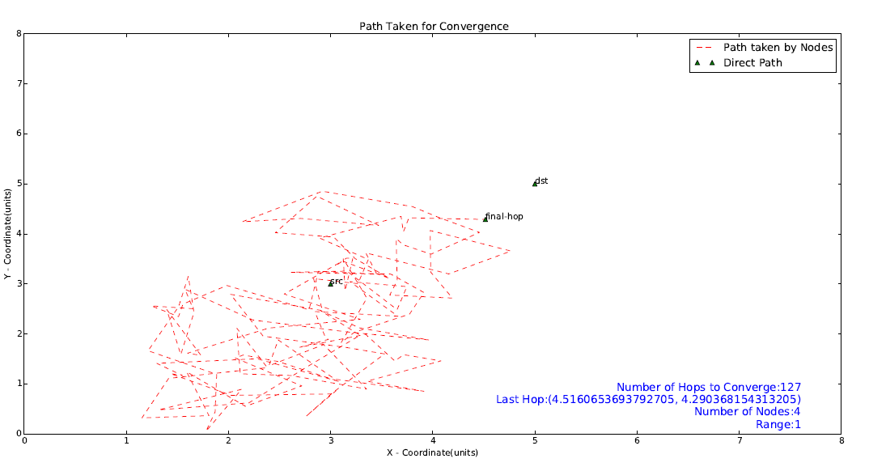
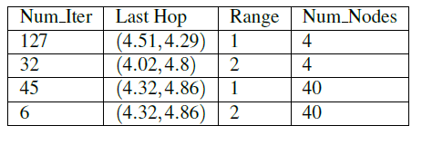
Result- Normal Distribution
Realm 5*5

Slide 11
Conclusion- Normal Distribution
Reduction in Hop-Count(Iterations) as number of nodes are increased.
Reduction in Hop-Count if the Range(‘R’) of each node is increased.

Slide 12
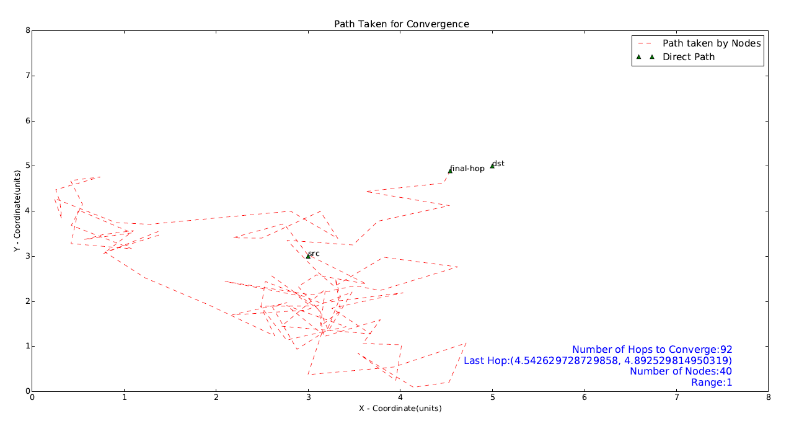
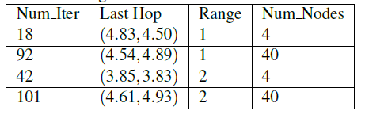
Result-Log Normal Distribution
Realm 5*5

Slide 13
Conclusion- Log-Normal Distribution
Oscillations in Hop-Count(Iterations) as number of nodes are increased.(counterintuitive)
Oscillations in Hop-Count if the Range(‘R’) of each node is increased. (counterintuitive)

Slide 14
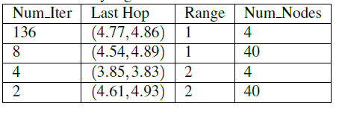
Result-Rayleigh Distribution
Realm 5*5
Fastest Convergence in all three
Drastic reduction in number of hops.

Slide 15
DEMO

Slide 16
Shortcomings & Future Work
Validate more distributions.
Algorithm fails if destination does not accept the message.
A neighbor node can chose not to accept the data causing more iterations.
Future Work
Validate data on real devices.

Slide 17

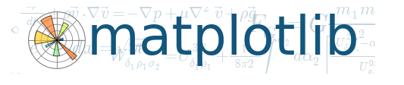

Questions?
Code available on Github: https://github.com/shivamchoudhary/eureka

